Slide 1
Analog to Digital Convertor

Slide 2
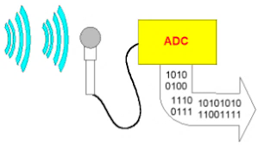
NEED FOR ADC

Slide 3
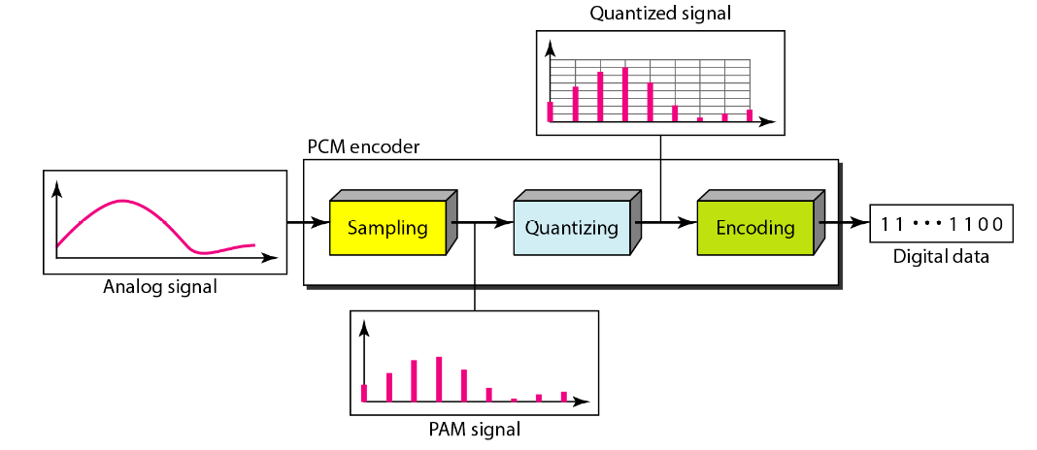
ADC
ADC

Slide 4
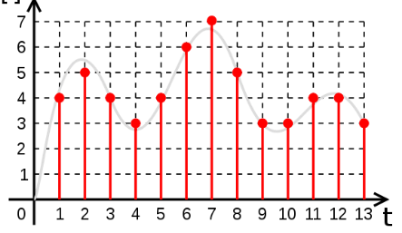
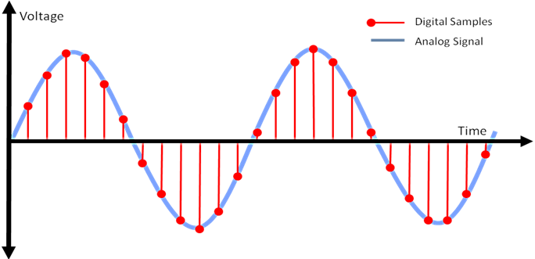
ADC
Sampling
Quantization &
Encoding
00,01,10,11
Sampled Voltage
t
Bin
11
10
01
00
3 2 1
1 2 3
1 2 3
V
Quantization &
Encoding
Sampling
Sampler captures/sample analog signal at different time instants
Quantizer and Encoding perform mapping of sampled signal with binary numbers

Slide 5
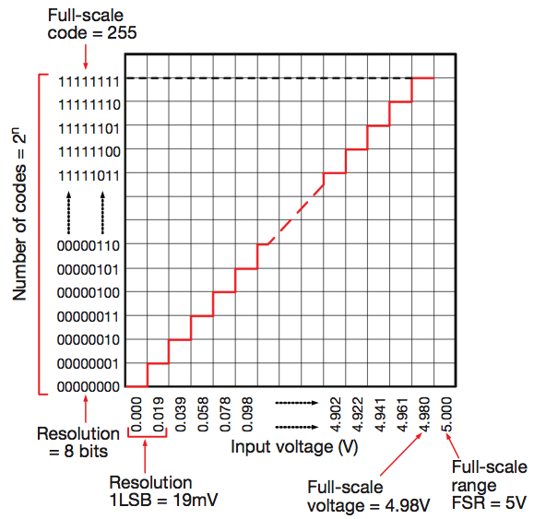
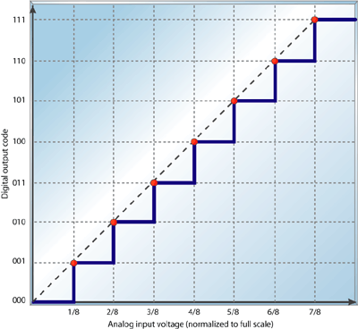
ADC

Slide 6
Intro
8 ADC’s (ANO-AN7) in PIC16F877A with 10-bit resolution
The A/D module has four registers. These registers are:
• 8- bit A/D Control Register 0 (ADCON0)
• 8- bit A/D Control Register 1 (ADCON1)
• 8- bit A/D Result High Register (ADRESH)
• 8- bit A/D Result Low Register (ADRESL)
What an is an analog signal??
Is D.C voltage analog?
Used to configure settings of ADC
Hold binary result of converted analog signal

Slide 7
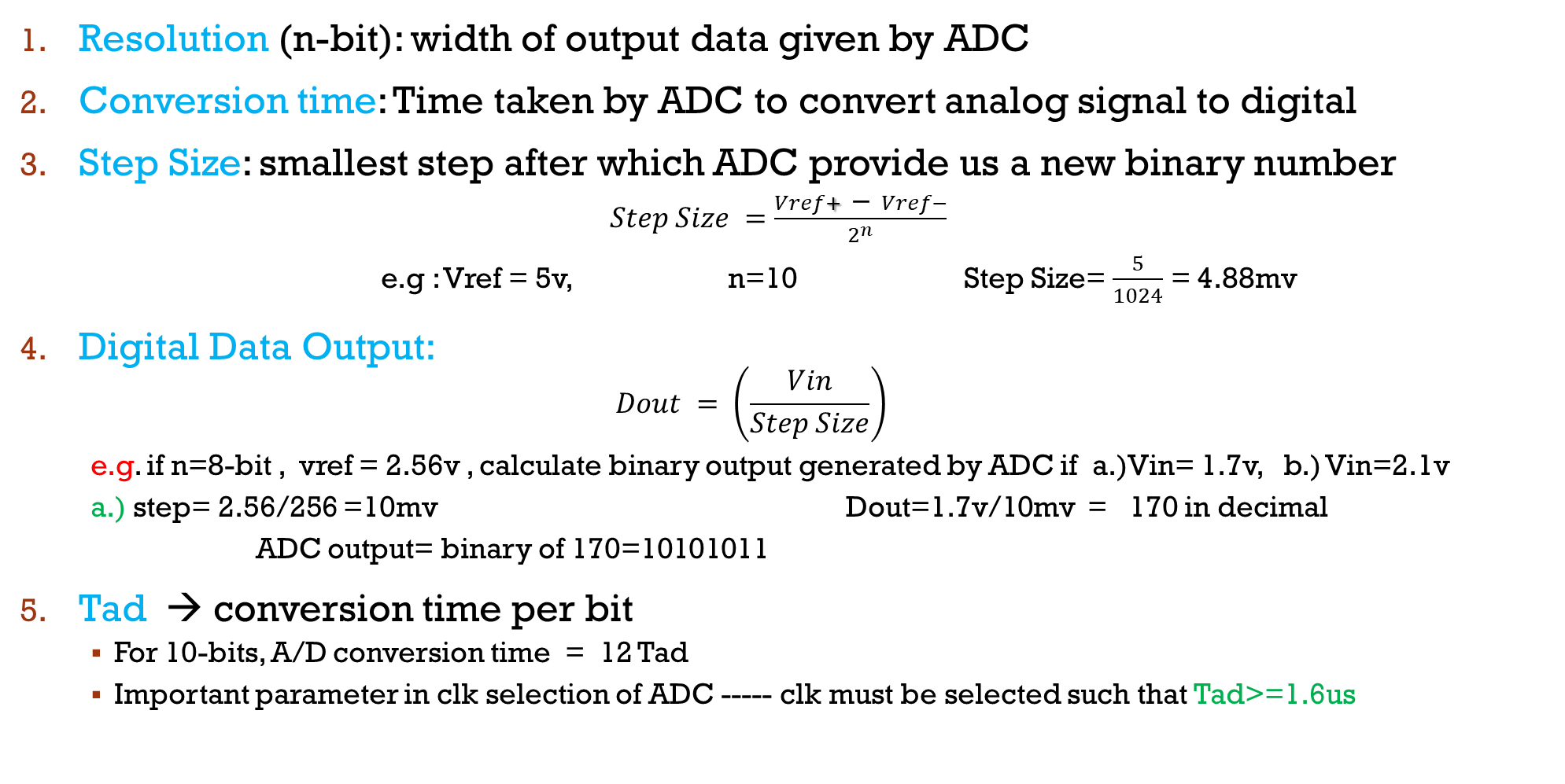
Some teRminoligies
Resolution (n-bit): width of output data given by ADC
Conversion time: Time taken by ADC to convert analog signal to digital
Step Size: smallest step after which ADC provide us a new binary number
$Step Size =\frac{Vref+ − Vref−}{2^{n}}$
e.g : Vref = 5v, n=10 Step Size= $\frac{5}{1024}$ = 4.88mv
Digital Data Output:
$$Dout = \left(\frac{Vin}{Step Size}\right)$$
e.g. if n=8-bit , vref = 2.56v , calculate binary output generated by ADC if a.)Vin= 1.7v, b.) Vin=2.1v
a.) step= 2.56/256 =10mv Dout=1.7v/10mv = 170 in decimal
ADC output= binary of 170=10101011
Tad → conversion time per bit
For 10-bits, A/D conversion time = 12 Tad
Important parameter in clk selection of ADC ----- clk must be selected such that Tad>=1.6us

Slide 8
INSIDE ADCON0 Register
Rule to select this clock?
clk must be selected such that Tad>=1.6us
E.g if XTAL=10Mhz, then for FOSC/2 we have … 10M/2=5Mhz
Tad=1/5M = 200ns <1.6us .. So its not valid clk
For FOSC/6??? And FOSC/32??? /32 is correct
bit 7-6 ADCS1:ADCS0: A/D Conversion Clock Select bits (ADCON0 bits in bold , ADCS2 bit is in ADCON1 reg)
<ADCS2:ADCS1:ADCS0> Clock Conversion
0 00 FOSC/2
0 01 FOSC/8
0 10 FOSC/32
0 11 FRC (clock derived from the internal A/D RC oscillator)
1 00 FOSC/4
1 01 FOSC/16
1 10 FOSC/64
1 11 FRC (clock derived from the internal A/D RC oscillator)

Slide 9
INSIDE ADCON0 Register
bit 5-3 CHS2:CHS0: Analog Channel Select bits
000 = channel 0, (AN0)
001 = channel 1, (AN1)
010 = channel 2, (AN2)
011 = channel 3, (AN3)
100 = channel 4, (AN4)
101 = channel 5, (AN5)
110 = channel 6, (AN6)
111 = channel 7, (AN7)
bit 2 GO/DONE’: A/D Conversion Status bit → indicates whether conversion completed or not?
When ADON = 1:
1 = A/D conversion in progress (setting this bit starts the A/D conversion which is automatically
cleared by hardware when the A/D conversion is complete)
0 = A/D conversion not in progress
bit 1 Unimplemented: Read as '0'
bit 0 ADON: A/D On bit
1 = A/D converter module is powered up
0 = A/D converter module is shut-off and consumes no operating current

Slide 10
INSIDE ADCON1 Register
bit 7 ADFM: A/D Result Format Select bit
1 = Right justified. Six (6) Most Significant bits of ADRESH are read as ’0’.
0 = Left justified. Six (6) Least Significant bits of ADRESL are read as ’0’.
bit 6 ADCS2: A/D Conversion Clock Select bit
Used to select clock source as explained in ADCON0
bit 5-4 Unimplemented: Read as '0'

Slide 11
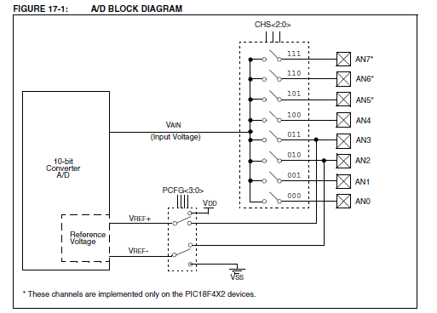
PIC ADC internal block diagram
10-bit binary

Slide 12
INSIDE ADCON1 Register
bit 3-0 PCFG3:PCFG0: A/D Port Configuration Control bits
A = Analog input
D = Digital I/O
C/R =
# of analog input channels / # of ADC voltage references

Slide 13
ADC coding steps
Load ADCON0 reg
Channel?
Clk Source?
ADON bit?
Load ADCON1 reg
Result format?
Pin settings?
Set Analog Channel as i/p
Give Some delay of about 1ms to capture i/p completely
Wait till conversion is complete by checking DONE bit
Goto next step according your requirement
Take binary result from ADRESL and ADRESH registers
Start conversion by setting GO bit to high

Slide 14
PROGRAM : WRITE A MIKRO-C PROGRAM TO GET DATA FROM CHANNEL0 (AN0/RA0) OF ADC AND DISPLAYS THE SAMPLED RESULT ON PORTC AND PORTD. THIS IS DONE EVERY QUARTER OF SECOND.
void main(void)
{
TRISC=0;
TRISD=0;
TRISA.TRISA0=1;
ADCON0= 0x81; // Fosc/64, Channel 0, A/D is on
ADCON1= 0xCE; // Right justified, Fosc/64, AN0 =Analog
while(1)
{
delay_ms(1); //Give A/D Channel time to sample
ADCON0.GO_DONE=1; //Start Converting
while(ADCON0.GO_DONE == 1); //wait for completion of conversion
PORTC=ADRESL; // Display low byte on PORT C
PORTD=ADRESH; //Display high byte on PORT D
delay_ms(250); //wait for one quarter of second
}
}
What would be amendment in this program if we want to display result of AN0 to PORTS, then wait for 1 sec and then display result of AN1 and then repeat this process continuously???

Slide 15
MikroC Library Functions for ADC
unsigned Adc_Read(char channel);
It returns 10-bit unsigned digitized number
of the specified analog channel.
PRACTICE: Do the code done in previous slides using library functions.
NOTE:
Don’t forget to do TRIS settings of analog channel being used!!!
Also call function Adc_init() function to initialize ADC module with RC internal clock.
// CODE: Fetch 10-bit digitized value against analog signal at AN2
unsigned int result; //variable to store data
TRISA.TRISA2=1; //AN2 as ip
Adc_init(); //initialize ADC module with internal RC clock
result = Adc_Read(2); //10-bit digitized result stored in result

Slide 16
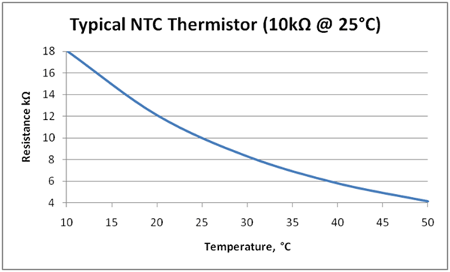
Scenario
Thermistor attached with AN2 of PIC….
Switch on AC relay attached with pin RC0 of PIC
And switch off HEATER relay attached with RD0 of PIC whenever temp>30 degree celcius
Switch off AC relay attached with pin RC0 of PIC
And switch on HEATER relay attached with RD0 of PIC whenever temp<25 degree celcius
Switch on both AC and HEATER relay otherwise

